Slide 1
INTRODUCTION TO
ALGORITHMS
FOURTH EDITION

Slide 2
LECTURE NOTES FOR CHAPTER 16
Amortized analysis

Slide 3
CHAPTER 16 OVERVIEW
Amortized analysis
Analyze a sequence of operations on a data structure.
Goal: Show that although some individual operations may be expensive, on average the cost per operation is small.
Average in this context does not mean that we’re averaging over a distribution of inputs.
No probability is involved.
We’re talking about average cost in the worst case.

Slide 4
CHAPTER 16 OVERVIEW (continued)
Organization
We’ll look at 3 methods.
aggregate analysis
accounting methods
potential method
Using 3 examples:
stack with multipop operation
binary counter
dynamic tables (later on)

Slide 5
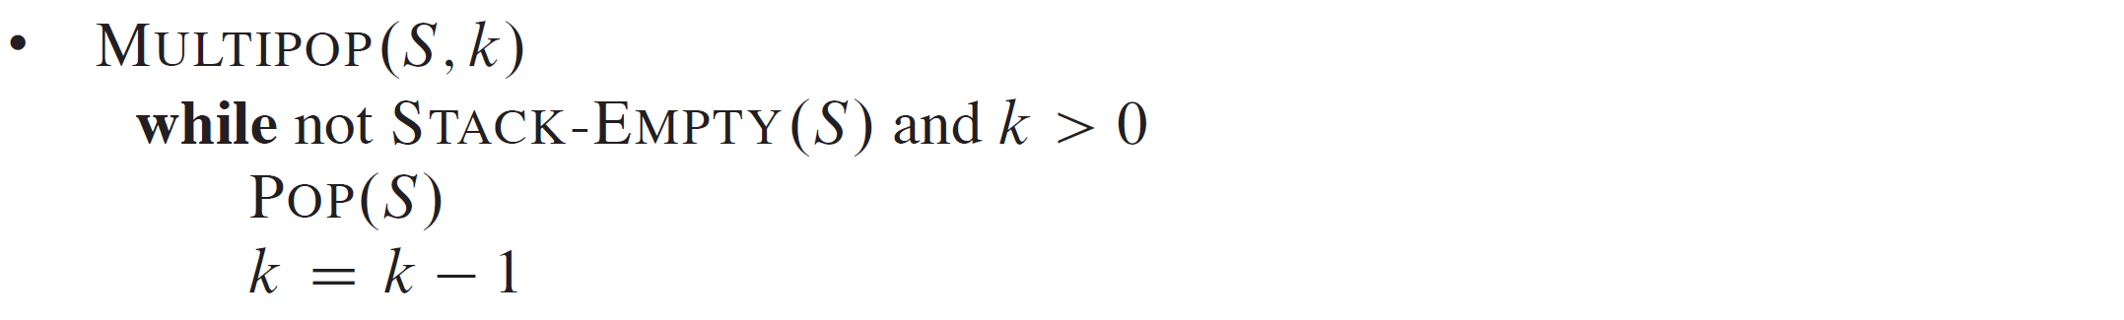
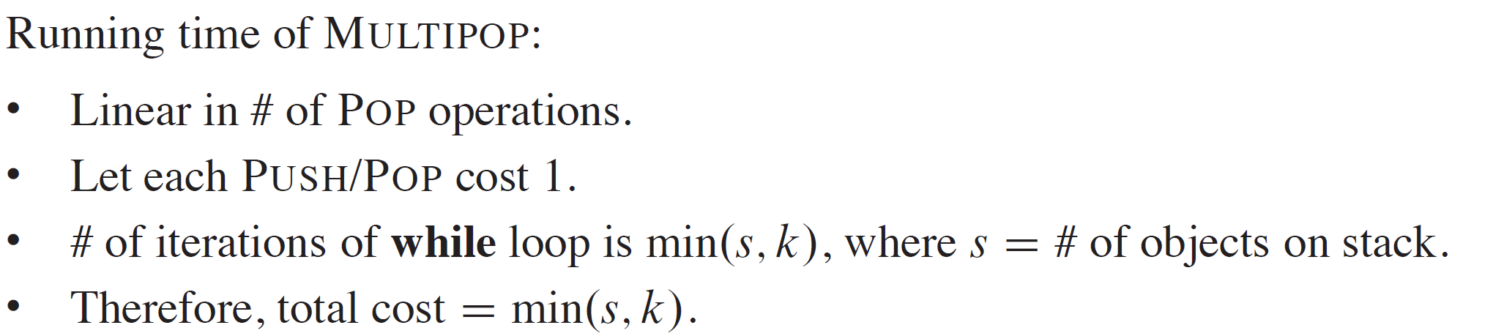
AGGREGATE ANALYSIS
Stack operations

Slide 6
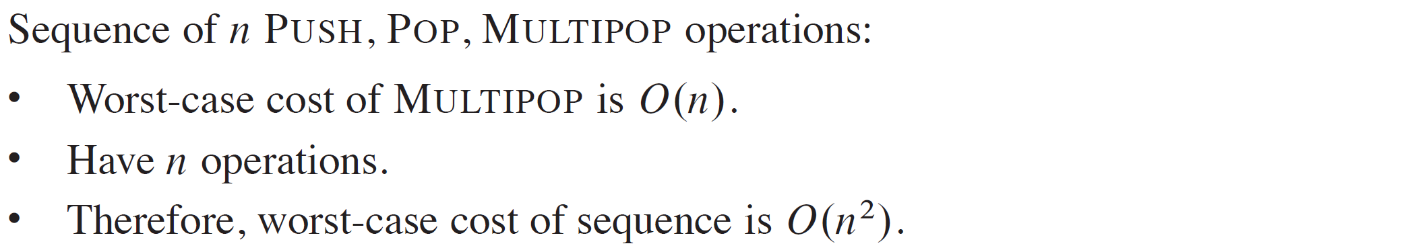
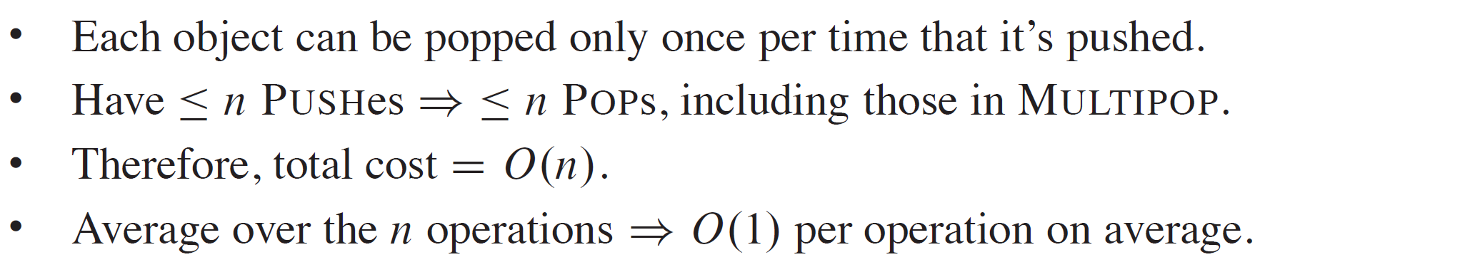
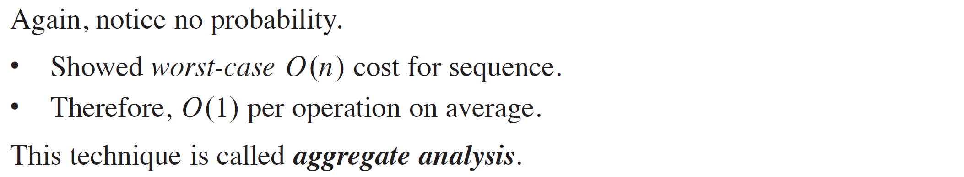
AGGREGATE ANALYSIS (continued)
Observation

Slide 7
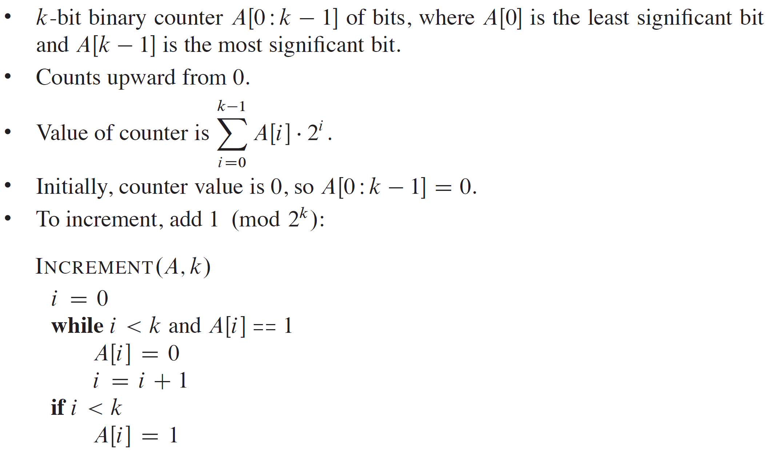
BINARY COUNTER

Slide 8
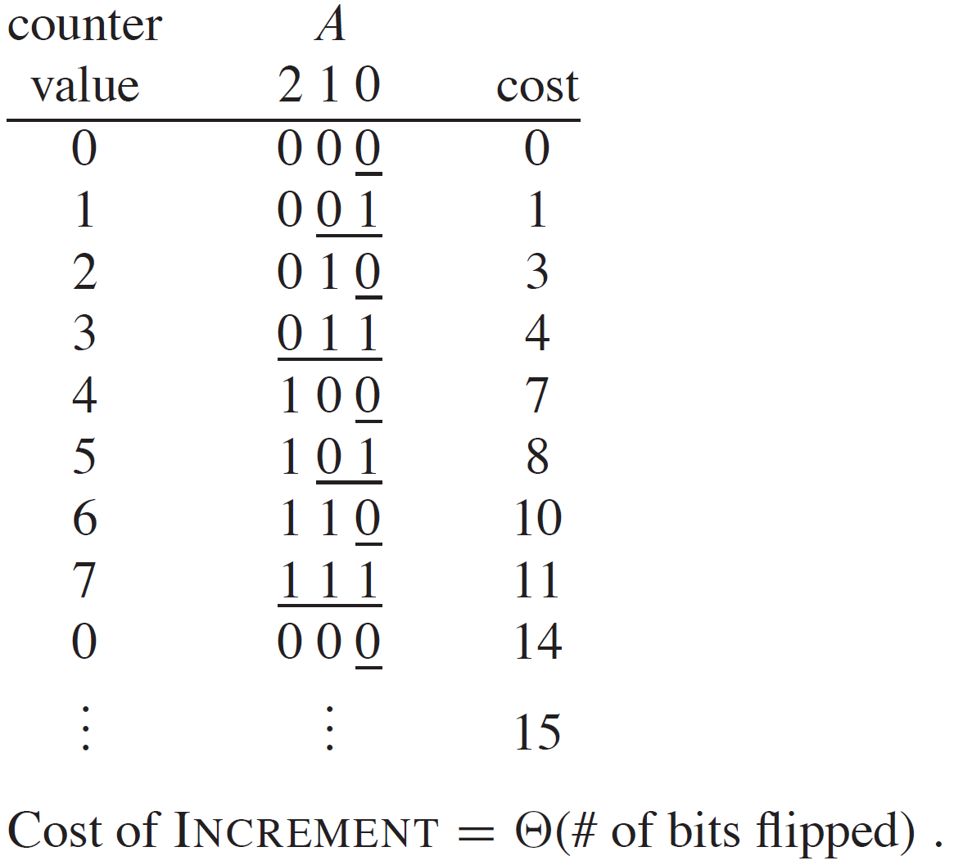


BINARY COUNTER EXAMPLE
Example: $k=3$ [Underlined bits flip.]
Analysis: Each call could flip $k$ bits, so $n$ INCREMENTS takes $O(nk)$time.
8

Slide 9
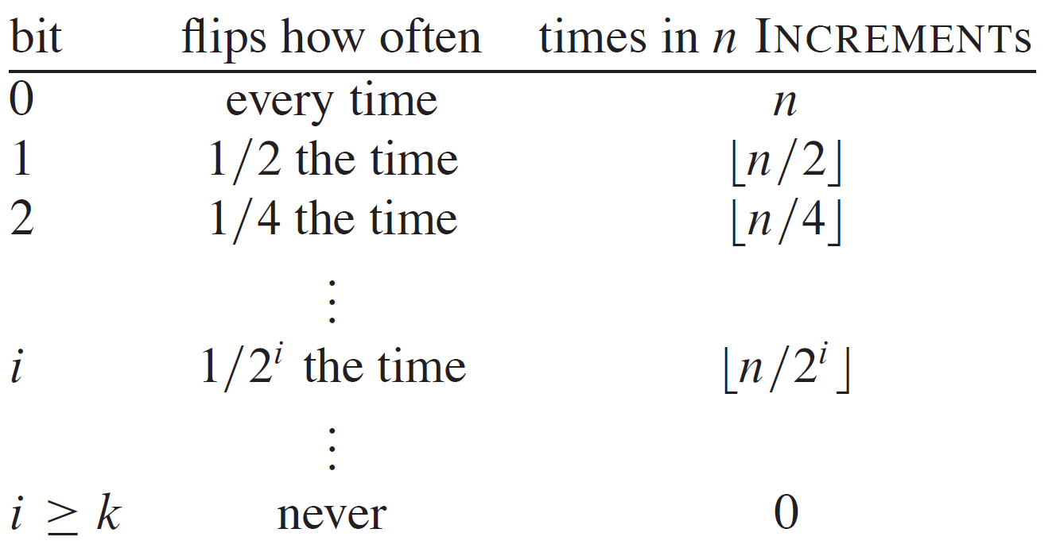
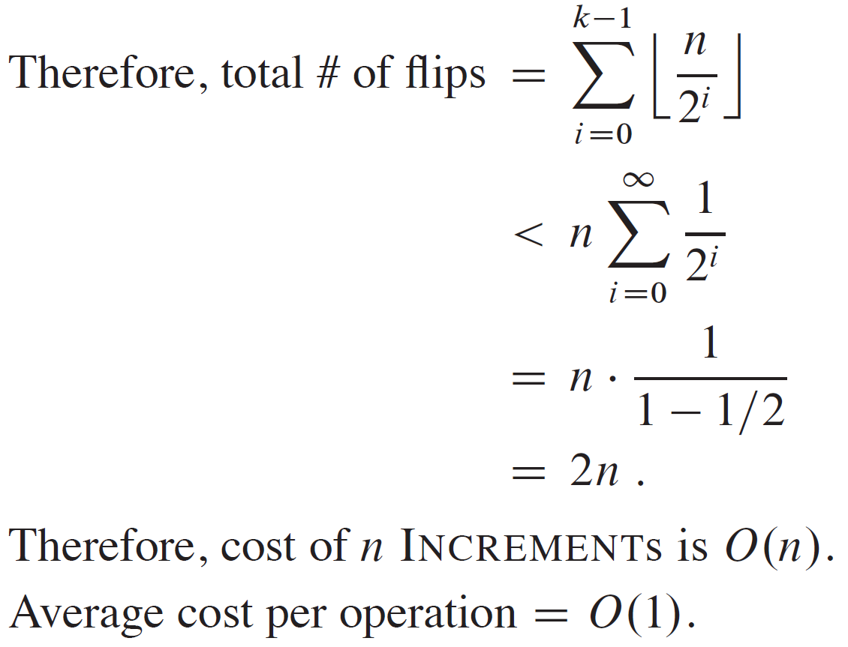
BINARY COUNTER OBSERVATION
Not every bit flips every time.

Slide 10
ACCOUNTING METHOD
Assign different charges to different operations.
Some are charged more than actual cost.
Some are charged less.
Assign different charges to different operations.
Some are charged more than actual cost.
Some are charged less.
Amortized cost = amount we charge.
When amortized cost > actual cost, store the difference on specific objects in the data structure as credit.
Assign different charges to different operations.
Some are charged more than actual cost.
Some are charged less.
Amortized cost = amount we charge.
When amortized cost > actual cost, store the difference on specific objects in the data structure as credit.
Use credit later to pay for operations whose actual cost > amortized cost. Differs from aggregate analysis:
In the accounting method, different operations can have different costs.
In aggregate analysis, all operations have same cost.

Slide 11
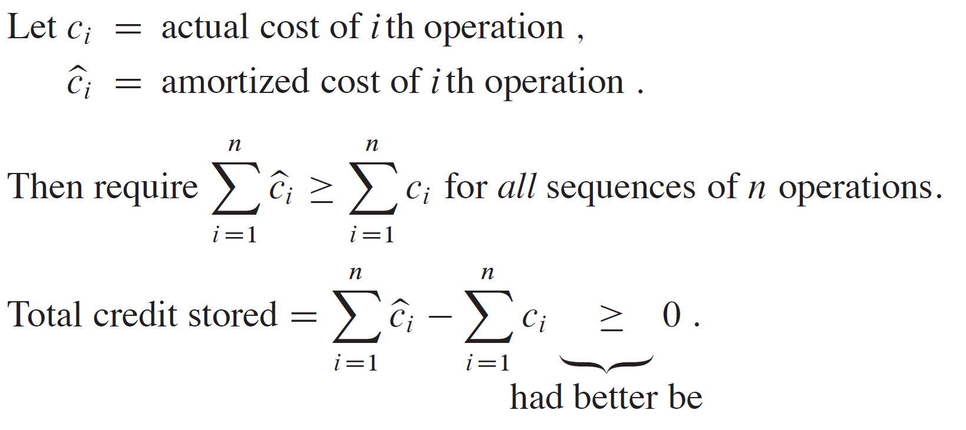
ACCOUNTING METHOD (continued)
Amortized cost = amount we charge.
Need credit to never go negative.
Otherwise, have a sequence of operations for which the amortized cost is not an upper bound on actual cost.
Amortized cost would tell us nothing.

Slide 12
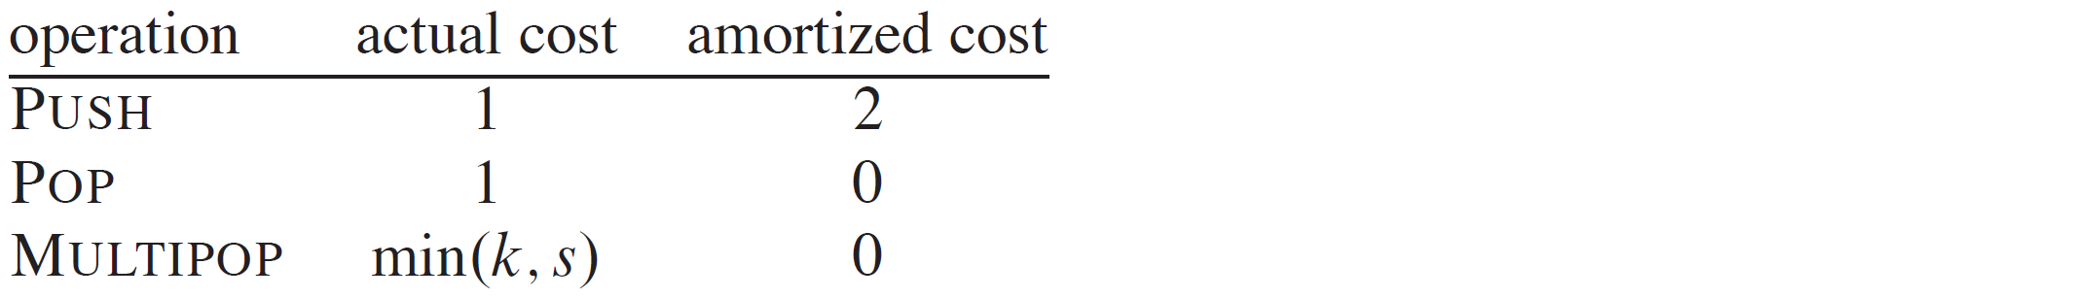
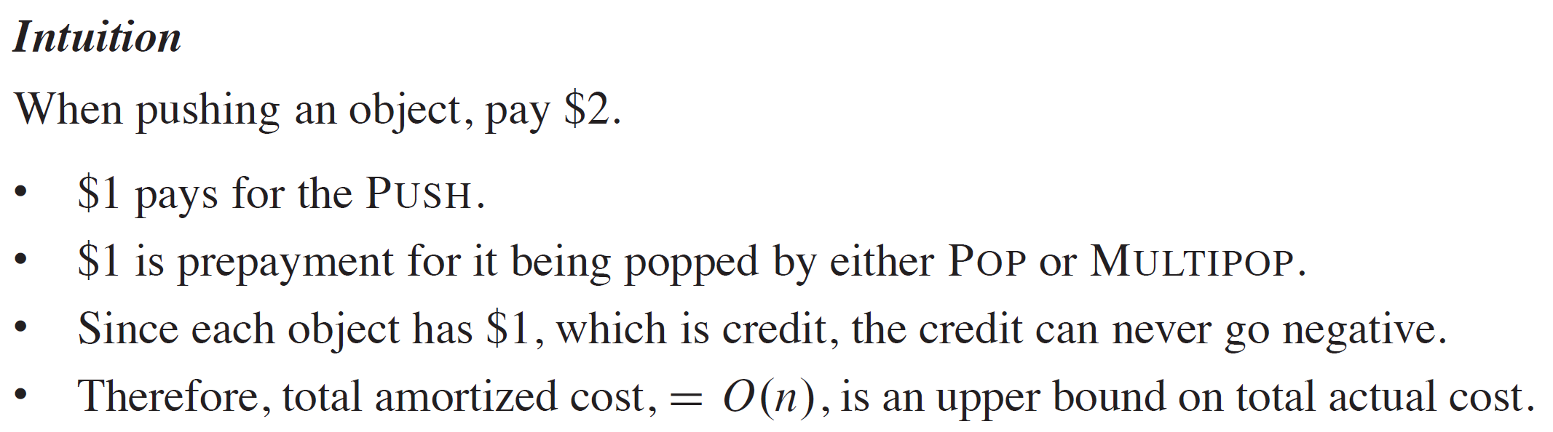
STACK

Slide 13
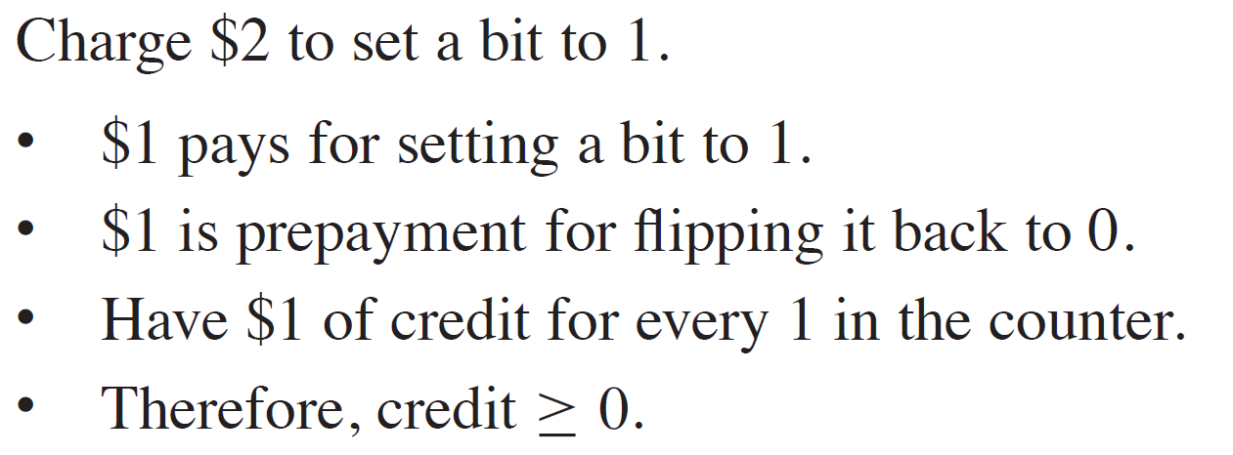
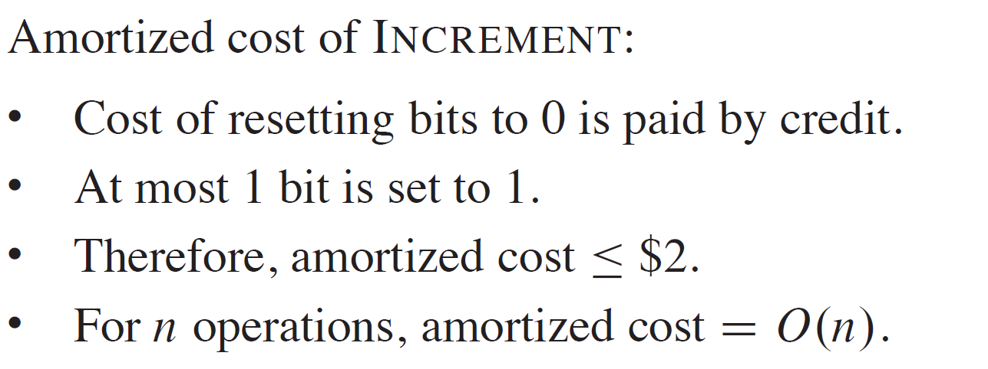
BINARY COUNTER

Slide 14
POTENTIAL METHOD
Like the accounting method, but think of the credit as potential stored with the entire data structure.
Accounting method stores credit with specific objects.
Potential method stores potential in the data structure as a whole.
Can release potential to pay for future operations.
Most flexible of the amortized analysis methods.

Slide 15
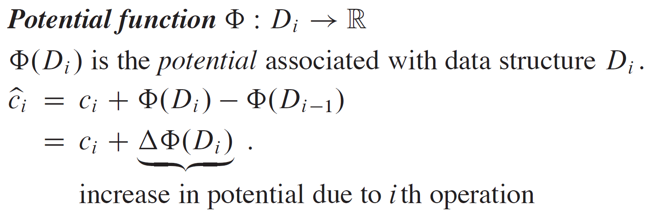
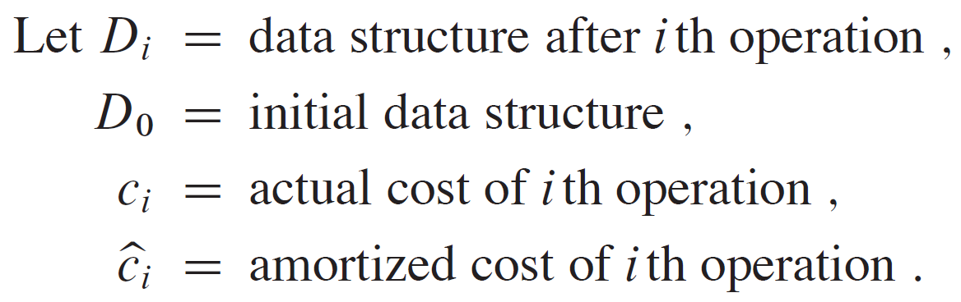
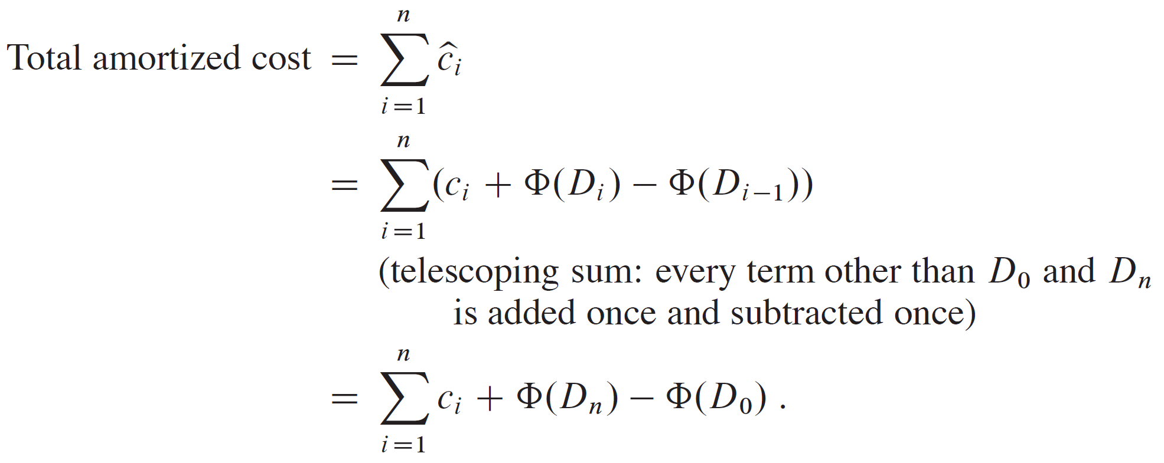
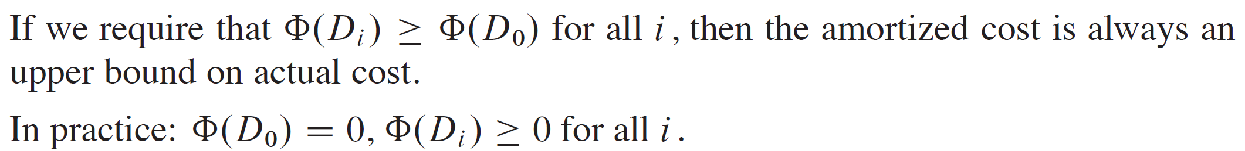
POTENTIAL METHOD (continued)

Slide 16
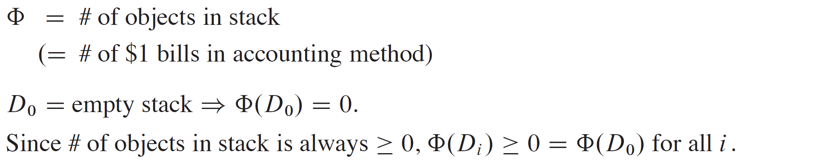
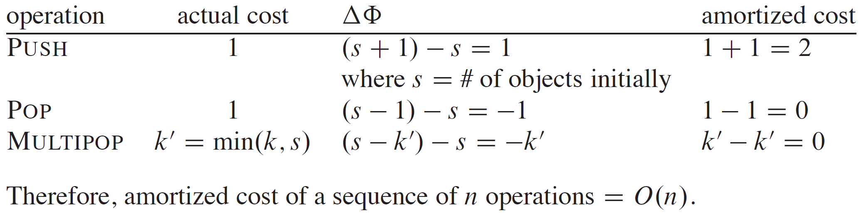
STACK

Slide 17
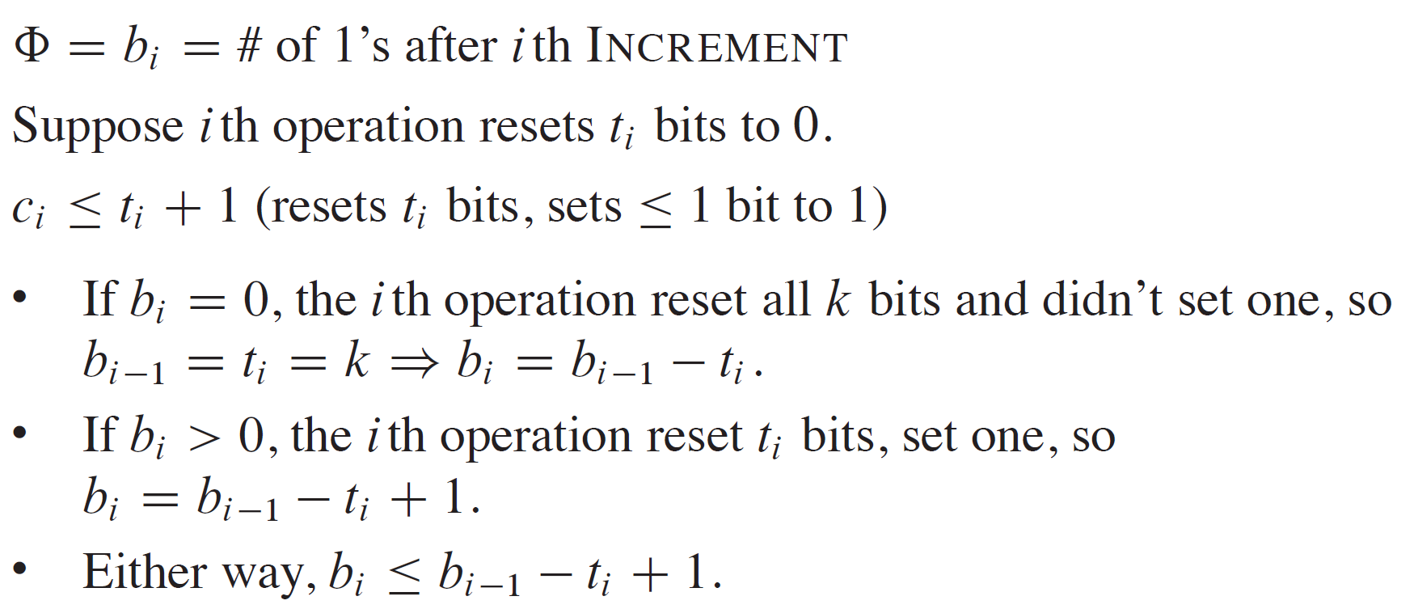
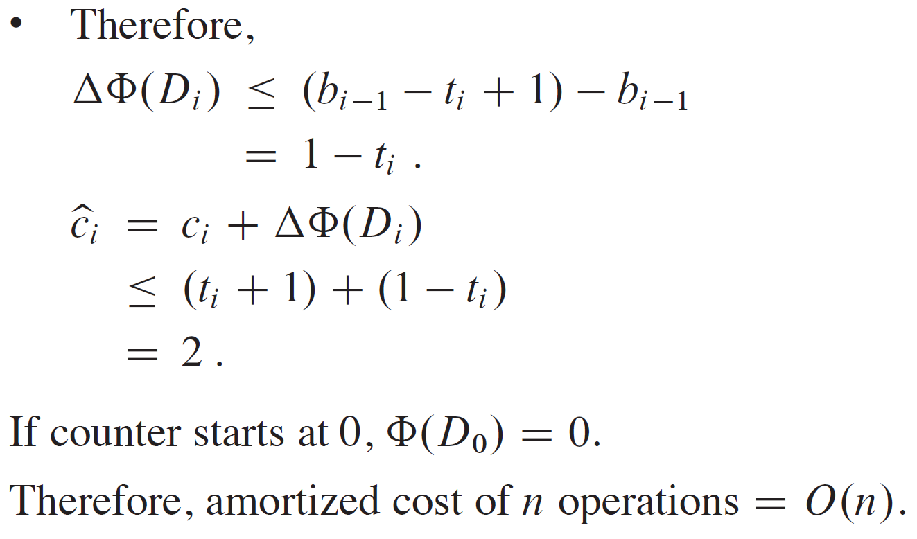
BINARY COUNTER

Slide 18
DYNAMIC TABLES
A nice use of amortized analysis.
Scenario
Have a table—maybe a hash table.
Don’t know in advance how many objects will be stored in it.
When it fills, must reallocate with a larger size, copying all objects into the new, larger table.
When it gets sufficiently small, might want to reallocate with a smaller size.
Details of table organization not important.

Slide 19
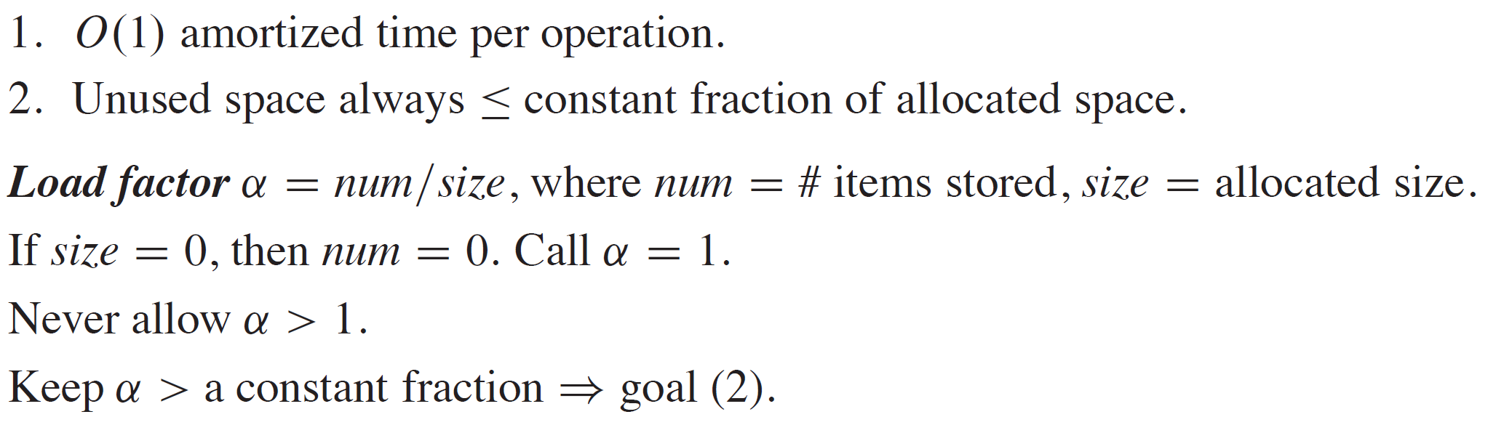
DYNAMIC TABLES (continued)
Goals

Slide 20
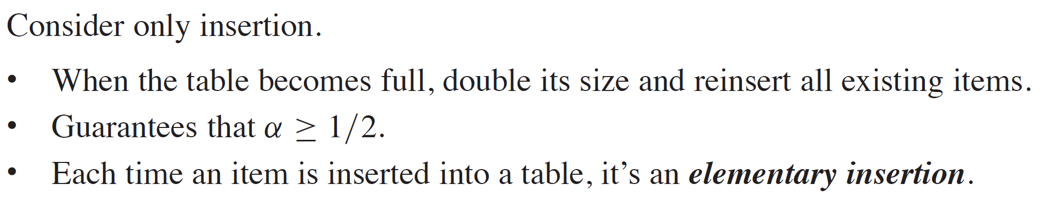
DYNAMIC TABLES (continued)
Table expansion

Slide 21
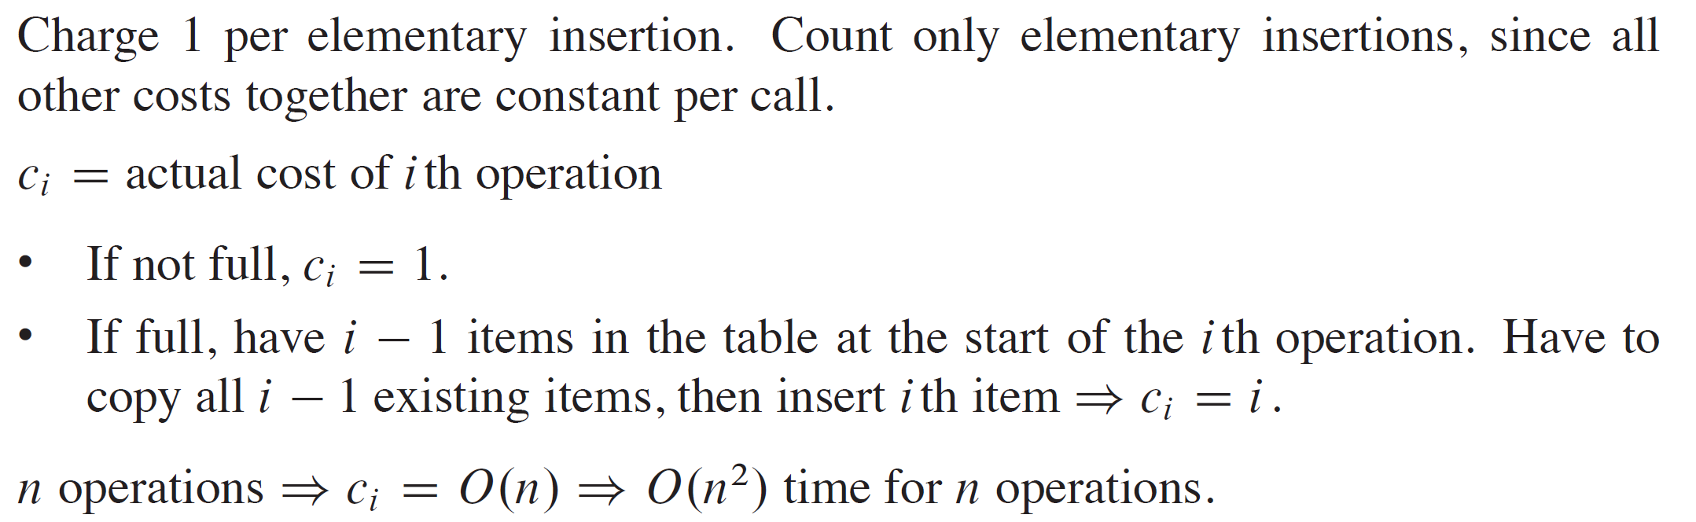
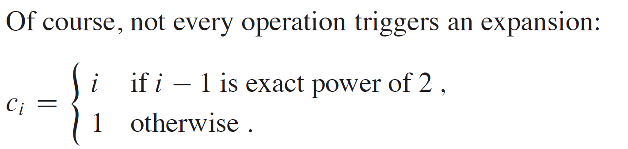
RUNNING TIME

Slide 22
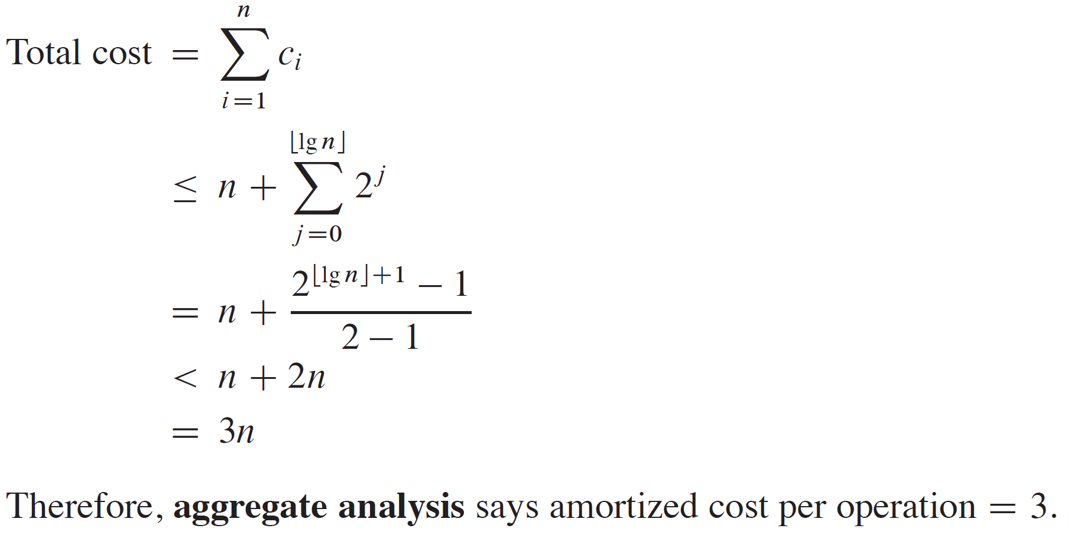
RUNNING TIME (continued)

Slide 23
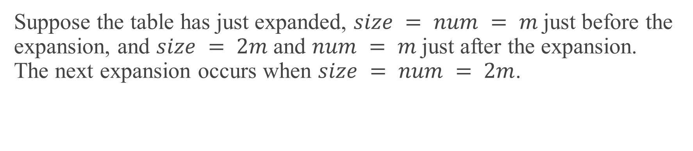
ACCOUNTING METHOD
Charge $3 per insertion of x.
$1 pays for x’s insertion.
$1 pays for x to be moved in the future.
$1 pays for some other item to be moved.
Suppose the table has just expanded, $size = num = m$just before the expansion, and $size = 2m$and $num = m$just after the expansion. The next expansion occurs when $size = num = 2m$.

Slide 24
ACCOUNTING METHOD (continued)
Assume that the expansion used up all the credit, so that there’s no credit stored after the expansion.
Will expand again after another m insertions.
Each insertion will put $1 on one of the m items that were in the table just after expansion and will put $1 on the item inserted.
Have $2m of credit by next expansion, when there are 2m items to move. Just enough to pay for the expansion, with no credit left over!

Slide 25
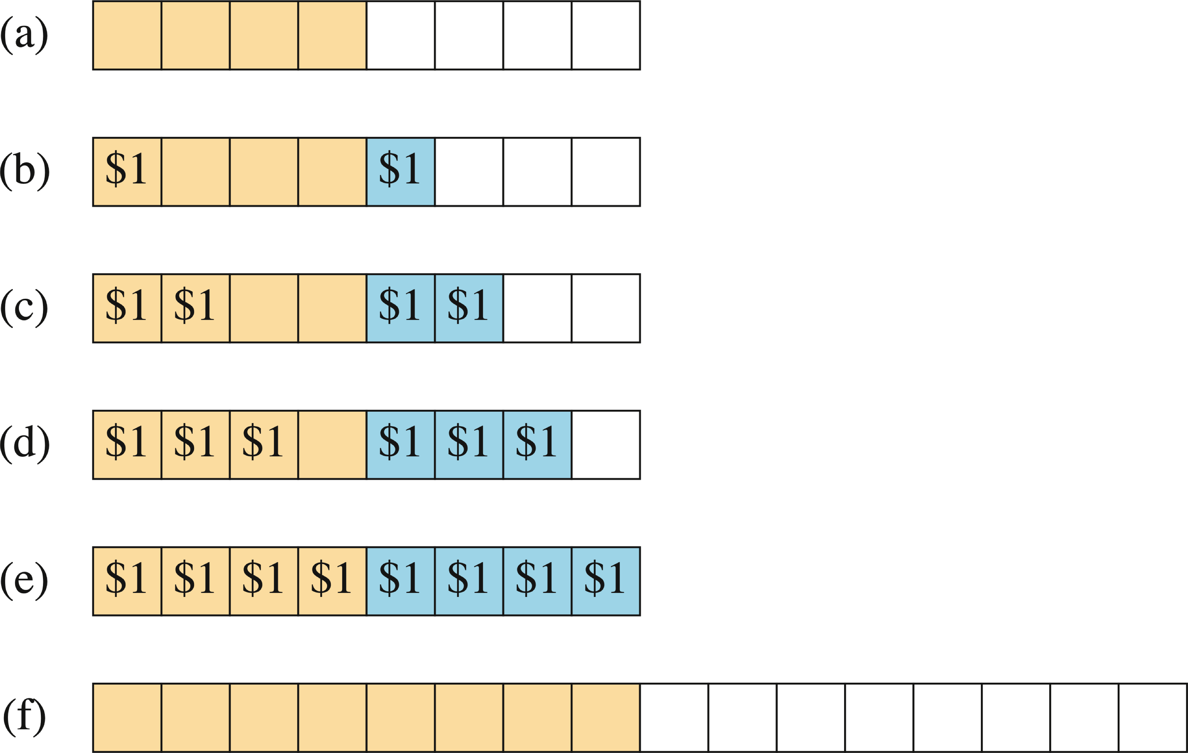
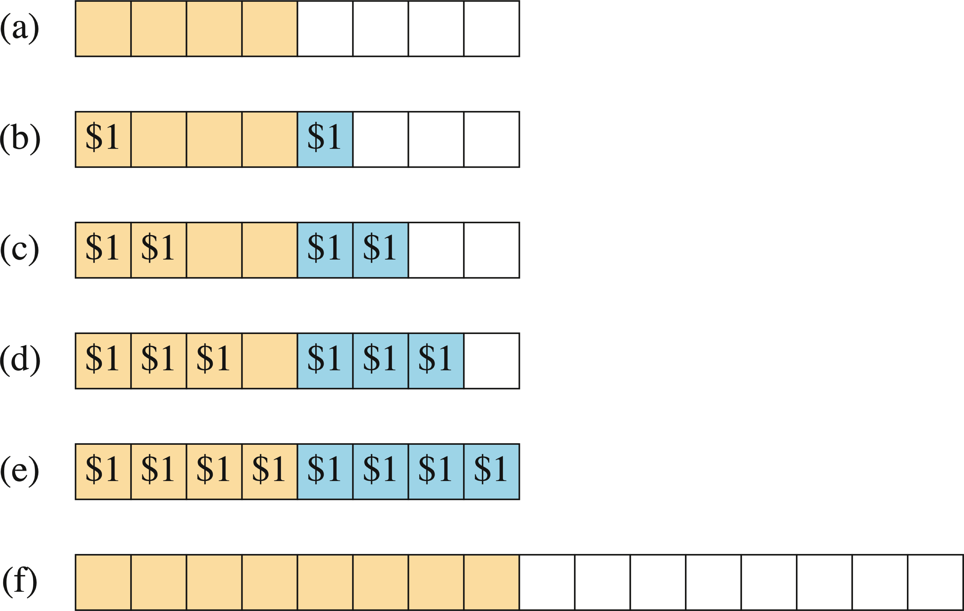
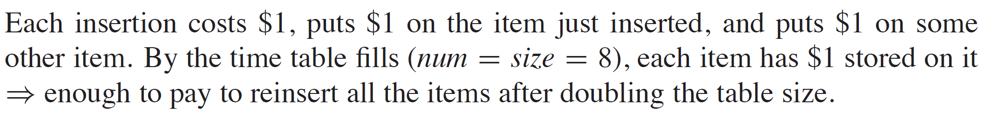
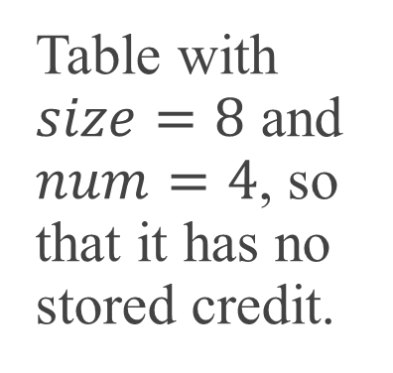
EXAMPLE
Table with $size=8$ and $num=4$, so that it has no stored credit.

Slide 26
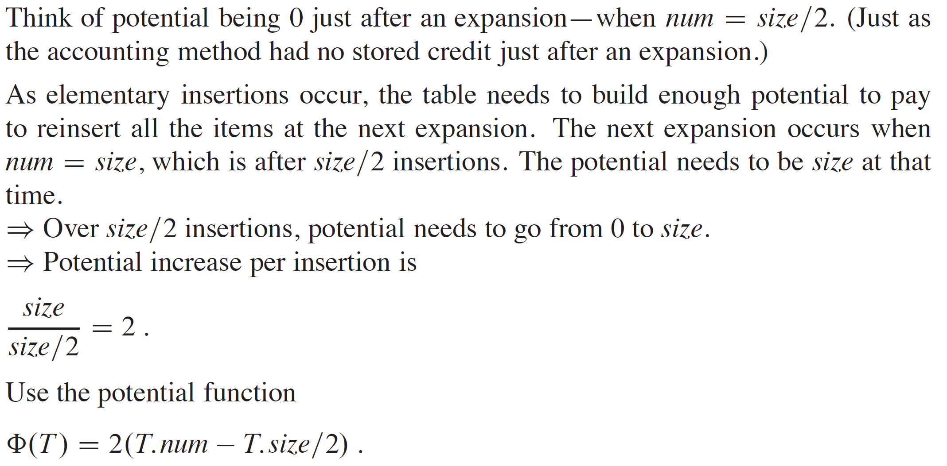
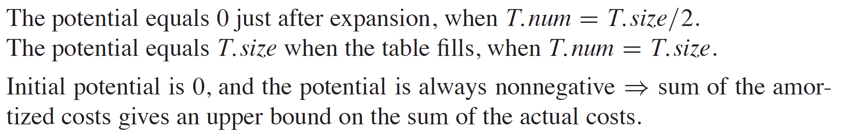
POTENTIAL METHOD

Slide 27
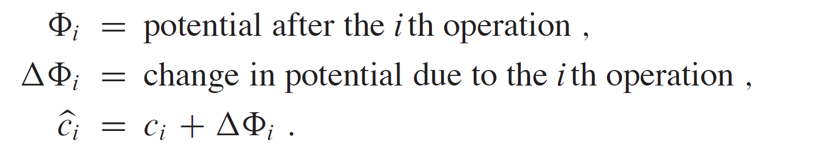
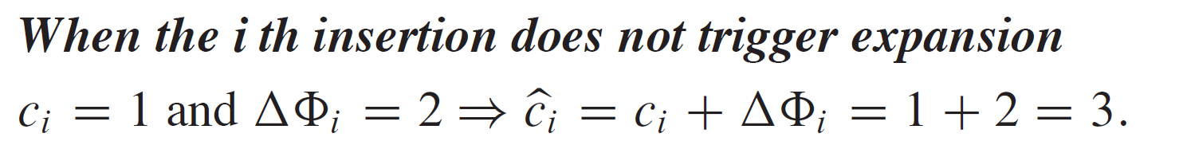
POTENTIAL METHOD (continued)

Slide 28
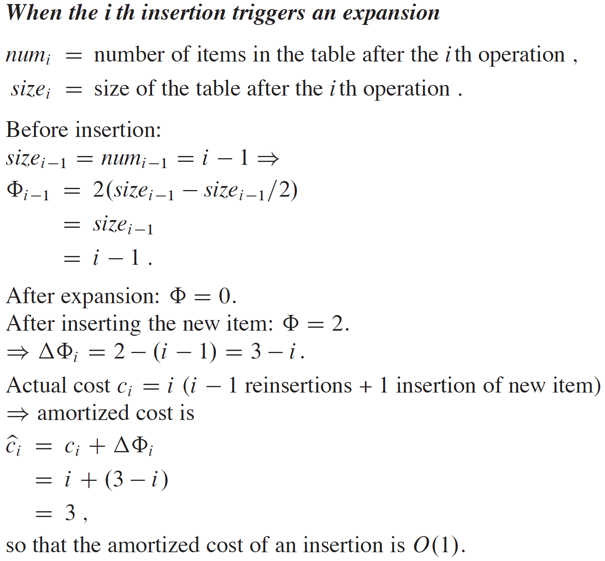
POTENTIAL METHOD (continued)

Slide 29
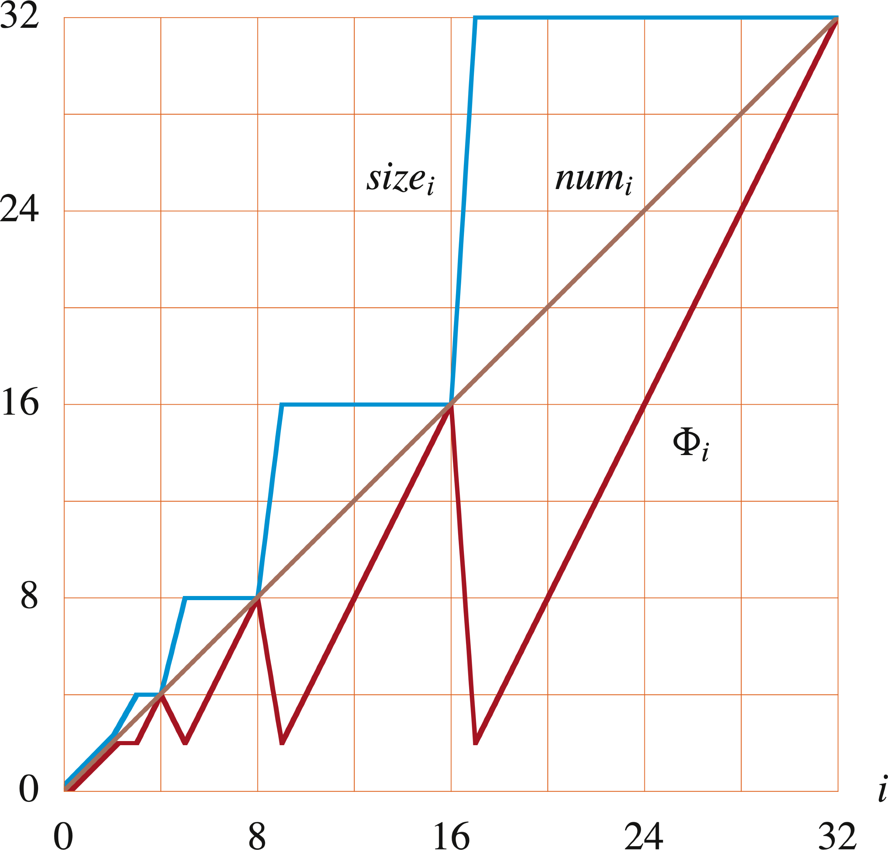
POTENTIAL METHOD (continued)

Slide 30
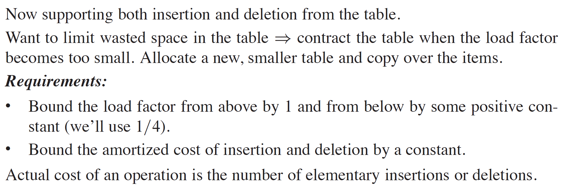
TABLE EXPANSION AND CONTRACTION

Slide 31
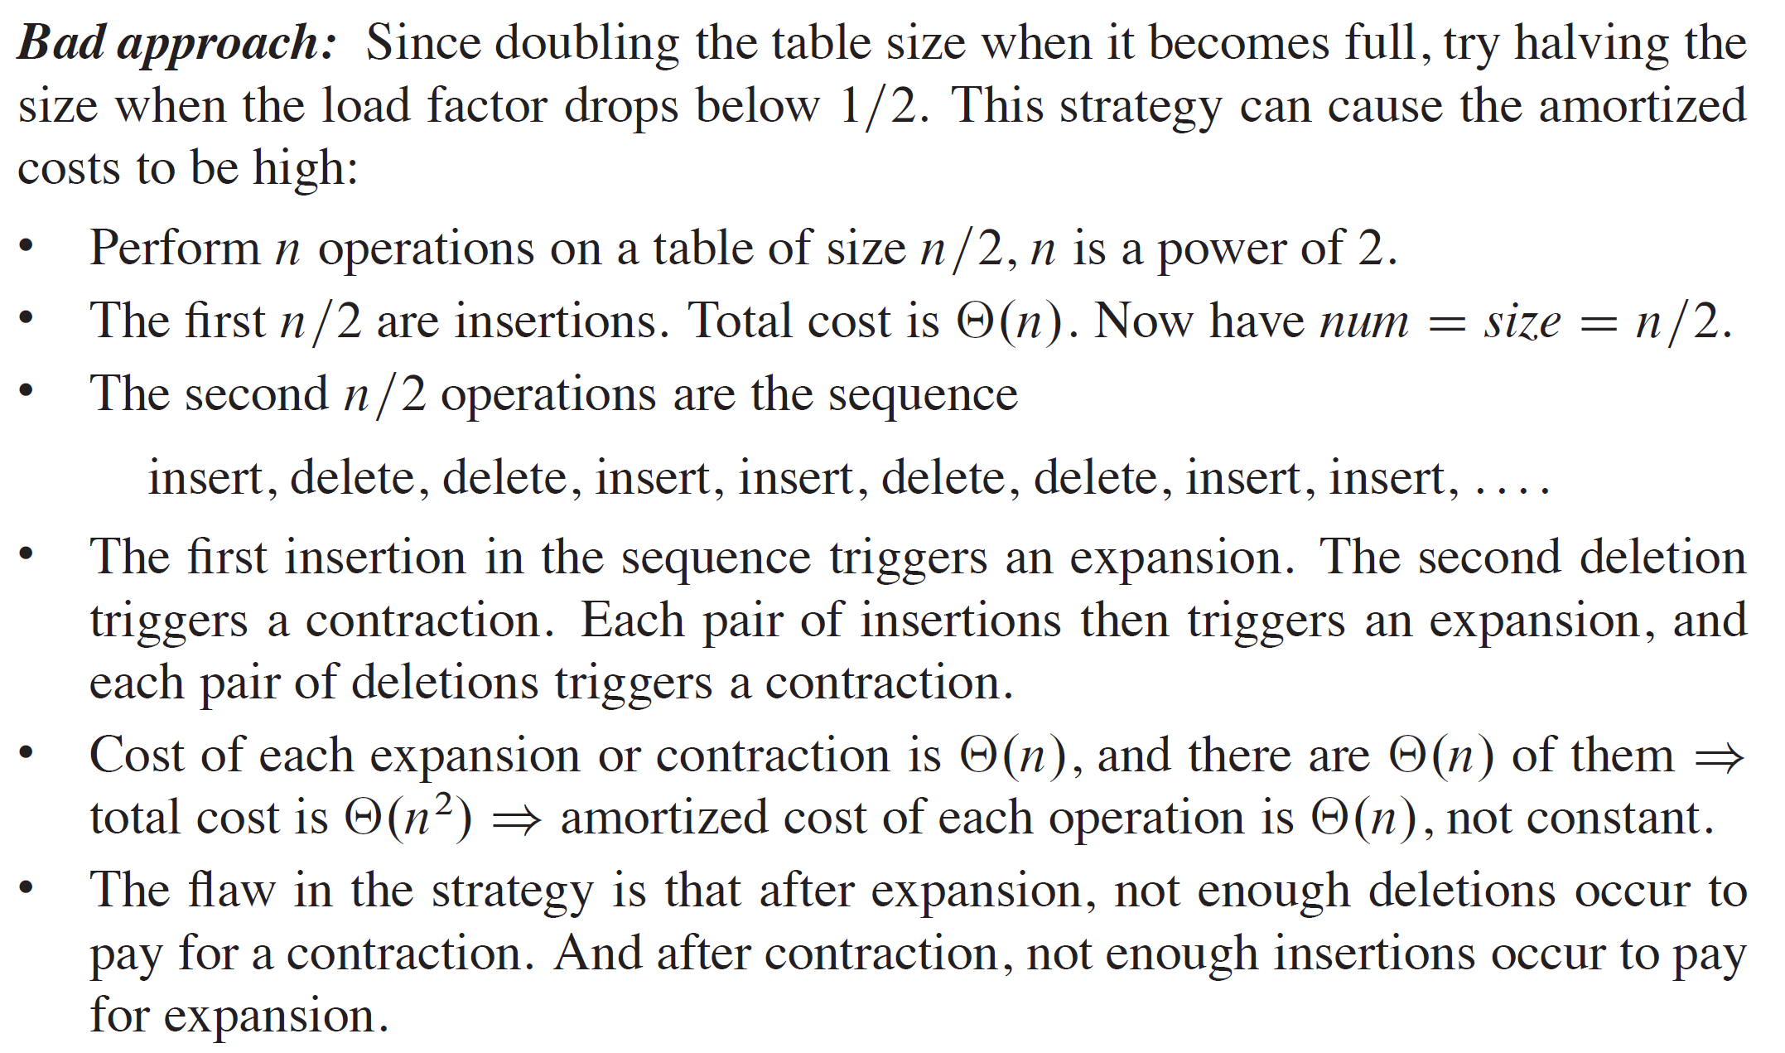
TABLE EXPANSION AND CONTRACTION (continued)

Slide 32
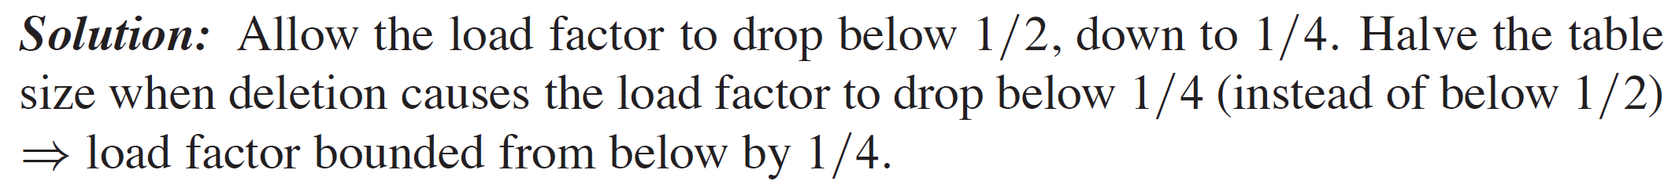
TABLE EXPANSION AND CONTRACTION (continued)

Slide 33
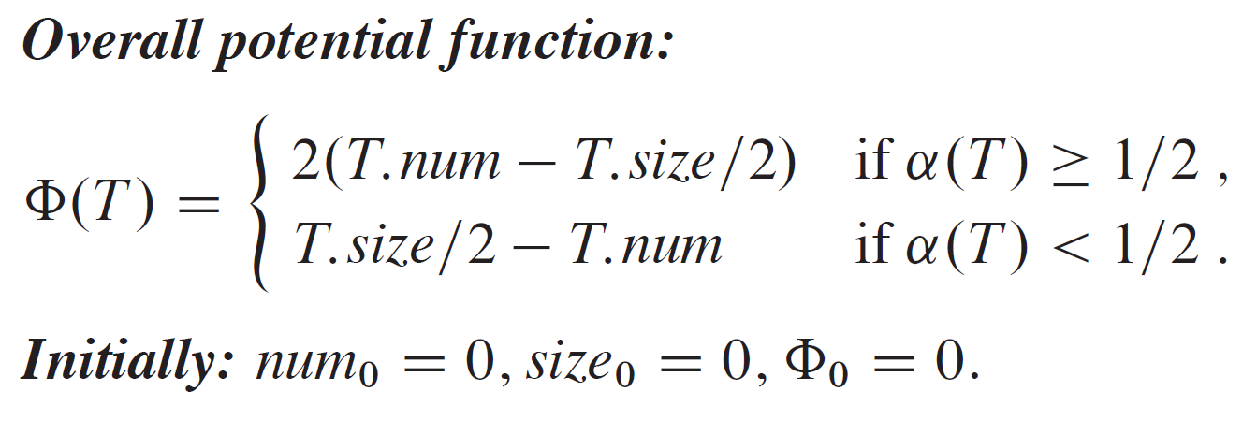
FUNCTION

